Slide 1
Discussion 9
Interpreters & Tail Calls
Jason Zhou | Section 136
CS61A Spring 2019

Slide 2
Announcements
Today: Lab 10, Scheme Part I
4/18: Scheme Part II
4/24: Scheme Full Project
4/23 Scheme +1 EC

Slide 3
Agenda
Interpreters II
Tail Calls Review

Slide 4
Interpreters
Lab: Interpret a small version of Python (PyCombinator) in Python
Project: Interpret Scheme in Python
Discussion: Interpret a small version of Scheme (Calculator) in Python
Interpretation Process (REPL):
Input > Lexer > Parser > Eval < > Apply > Print > Output
(+ 2 4) > Lexer > [“(“, “+”, “2”, “4”, “)”] > Parser > Pair(“+”, Pair(2, Pair(4, nil)))
Need to represent Scheme Lists in Python
Using “Pair” Class in Python to represent Scheme Lists
Attributes: .first, .second

Slide 5
Evaluation
When given an expression, how do we find out its value?
Different evaluation rules for different data types, expressions, etc.
Primitives: Self-evaluating (i.e. “1” evaluates to the number 1)
Names: Evaluate in context environment
Environment: just a mapping of names to values (each name has a value)
Dictionary data structure
In today’s discussion: dictionary called OPERATORS
i.e. “+” symbol maps to sum() function

Slide 6
Evaluation
Call Expressions: Evaluate operator, Evaluate operands, Apply operator to operands
Special Forms: and, or, define, if, cond, etc.
Different for every special form

Slide 7
Evaluation
Special form | Rules for evaluation
begin | evaluate all operands
and | evaluate operands until one evaluates to a false-y value
or | evaluate operands until one evaluates to a truth-y value
cond | evaluate predicate expressions until one evaluates to a truth-y value, then evaluate the corresponding return expression
if | evaluate the predicate, then evaluate the 2nd operand if the predicate is truth-y or the 3rd operand if the predicate is false-y
let | evaluate expressions in bindings, then evaluate expressions in the body
define (procedure) | no evaluation
define (name) | evaluate last operand
lambda | no evaluation
quote | no evaluation

Slide 8
Example Walkthrough:
Given expression (+ 1 2), how many calls to eval/apply?
First, always must call eval on given expression
Observe that it is not a special form (by looking at the first element, “+”)
This must be a call expression
Follow CallExpr rules: evaluate operator, evaluate 2 operands
Evaluating “+” gives us the addition function
Evaluating “1” gives us the number 1
Evaluating “2” gives us the number 2
Apply addition function to numbers 1 and 2 to obtain 3
4 Eval, 1 Apply

Slide 9
Example Walkthrough:
Given expression (and (+ 1 2) 3), how many calls to eval/apply?
First, always must call eval on given expression
Observe that it is a special form (by looking at the first element, “and”)
Follow “and” special form rules: evaluate operands until one evaluates to a falsey value
Evaluating (+ 1 2) ... 3 Evals left and 1 Apply required
Evaluating “3” gives us the number 3
6 Eval, 1 Apply

Slide 10
Example Walkthrough:
Given expression (and nil (+ 1 2)), how many calls to eval/apply?
First, always must call eval on given expression
Observe that it is a special form (by looking at the first element, “and”)
Follow “and” special form rules: evaluate operands until one evaluates to a falsey value
Evaluating nil gives us an instance of the nil class
nil class defined on page 2 of discussion, purely defined to represent Scheme’s nil
Short-circuit!
2 Eval

Slide 11
Tail Calls/Tail Recursion
def factorial(n):
if n == 0:
return 1
else:
return n * factorial(n-1)
def factorial(n, answer=1):
if n == 0:
return answer
else:
return factorial(n-1, n*answer)
Return value is a single function call
A call is “in tail context” if it is the last action the function takes

Slide 12
Exam Prep

Slide 13
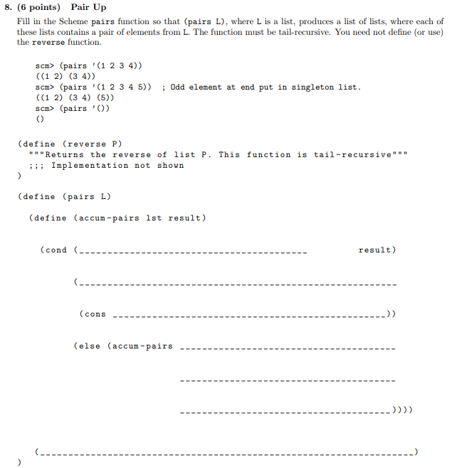

Slide 14
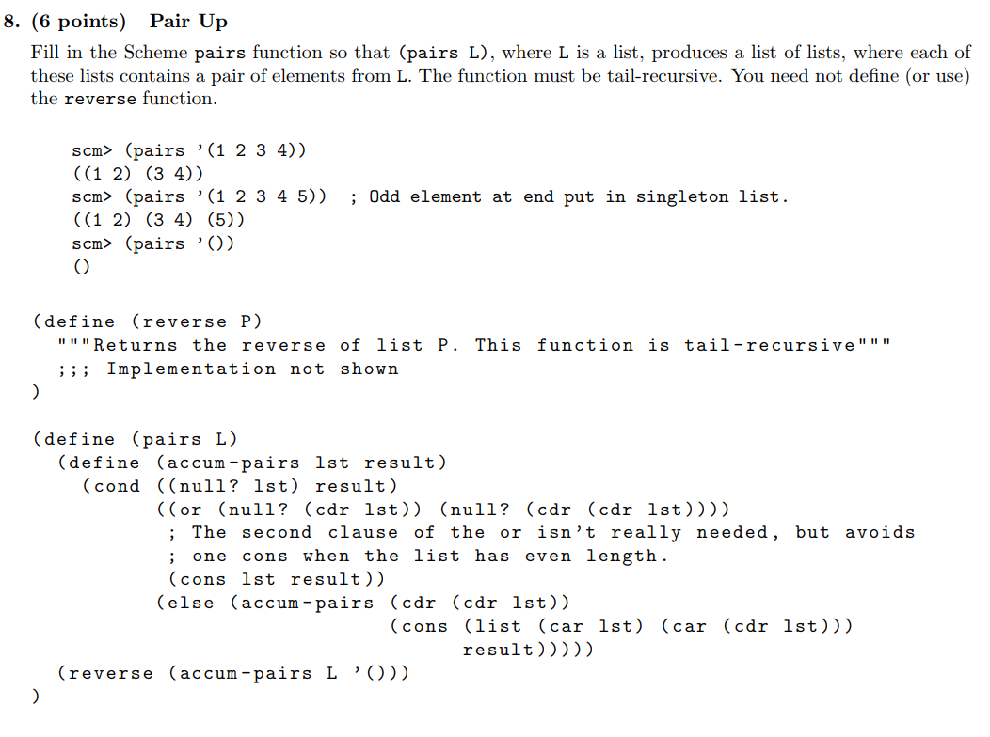

Slide 15
Attendance
links.cs61a.org/jasonz-attendance

Slide 16
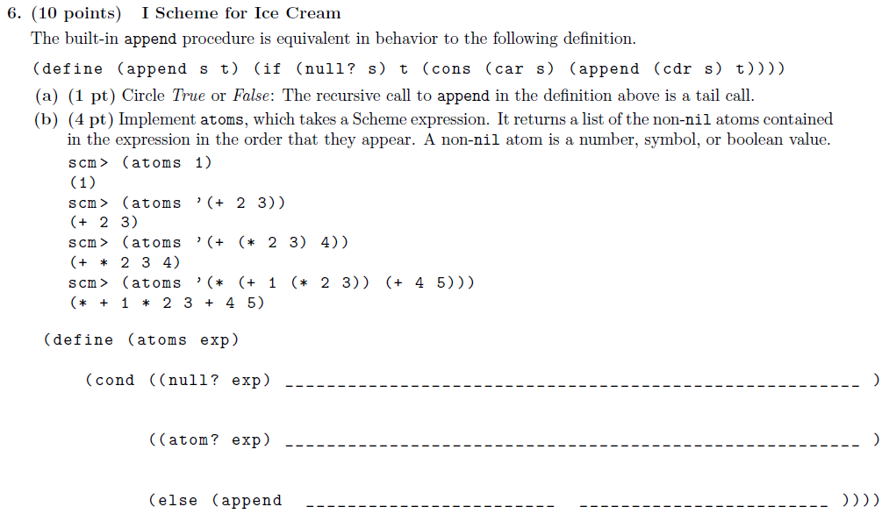

Slide 17
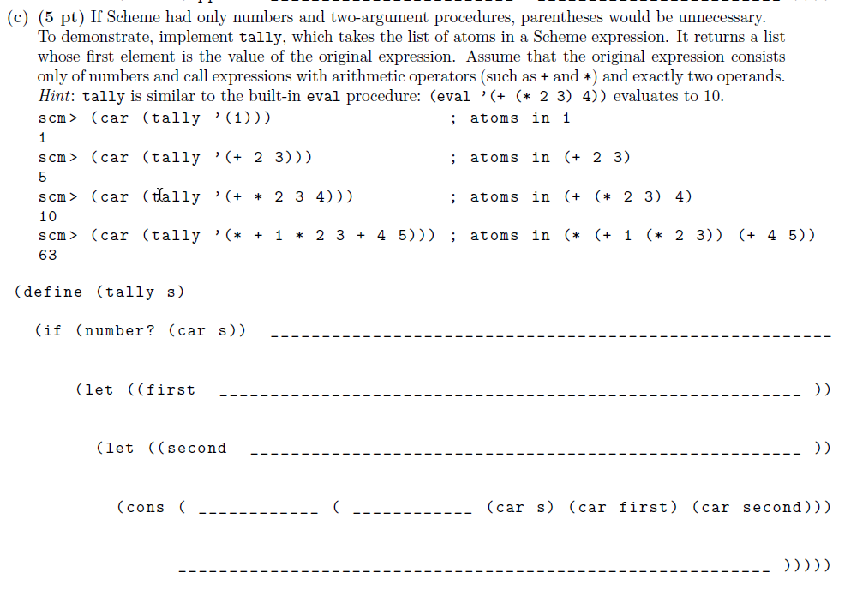

Slide 18
SF | Rules for evaluation
begin | evaluate all operands
and | evaluate operands until one evaluates to a false-y value
or | evaluate operands until one evaluates to a truth-y value
cond | evaluate predicate expressions until one evaluates to a truth-y value, then evaluate the corresponding return expression
if | evaluate the predicate, then evaluate the 2nd operand if the predicate is truth-y or the 3rd operand if the predicate is false-y
let | evaluate expressions in bindings, then evaluate expressions in the body
define (p) | no evaluation
define (n) | evaluate last operand
lambda | no evaluation
quote | no evaluation
Expression | # eval | # apply
(+ 2 3 (- 4 5) 1)
(begin (define (foo x) (+ x 3)) (foo (- 5 2)))
(define a 2) (define (b) 3) (let ((b a) (a (b))) ((lambda (x) (- x a b)) 5))

